Slide 1

© 2011 Pearson Education, Inc

Slide 2
Statistics for Business and Economics
Chapter 7
Inferences Based on Two Samples: Confidence Intervals & Tests of Hypotheses
© 2011 Pearson Education, Inc

Slide 3
Content
Identifying the Target Parameter
Comparing Two Population Means: Independent Sampling
Comparing Two Population Means: Paired Difference Experiments
Comparing Two Population Proportions: Independent Sampling
Determining the Sample Size
Comparing Two Population Variances: Independent Sampling
© 2011 Pearson Education, Inc
Notes:
As a result of this class, you will be able to ...

Slide 4
Learning Objectives
Learn how to compare two populations using confidence intervals and tests of hypotheses
Apply these inferential methods to problems where we want to compare
  Two population means
  Two population proportions
  Two population variances
© 2011 Pearson Education, Inc
Notes:
As a result of this class, you will be able to ...

Slide 5
Learning Objectives
3. Determine the sizes of the samples necessary to estimate the difference between two population parameters with a specified margin of error
© 2011 Pearson Education, Inc
Notes:
As a result of this class, you will be able to ...

Slide 6
7.1
Identifying the Target Parameter
© 2011 Pearson Education, Inc
Notes:
:1, 1, 3

Slide 7
Thinking Challenge
How would you try to answer these questions?
Who gets higher grades: males or females?
Which program is faster to learn: Word or Excel?
© 2011 Pearson Education, Inc

Slide 8
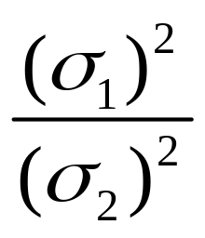
Determining the Target Parameter
Parameter | Key Words or Phrases | Type of Data
μ₁ – μ₂ | Mean difference; differences in averages | Quantitative
p₁ – p₂ | Differences between proportions, percentages, fractions, or rates; compare proportions | Qualitative
 | Ration of variances; differences in variability or spread; compare variation | Quantitative
© 2011 Pearson Education, Inc

Slide 9
7.2
Comparing Two Population Means: Independent Sampling
© 2011 Pearson Education, Inc
Notes:
:1, 1, 3

Slide 10
Sampling Distribution
Population
σ
σ
1
2
Population
1
2
μ
μ
1
2
Select simple random sample, n₁. Compute X₁
Compute X₁ – X₂ for every pair of samples
Select simple random sample, n₂. Compute X₂
Astronomical number
of X₁ – X₂ values
Sampling
Distribution
μ
-
μ
1
2
© 2011 Pearson Education, Inc
Notes:
32
In this diagram, do the populations have equal or unequal variances? Unequal.

Slide 11
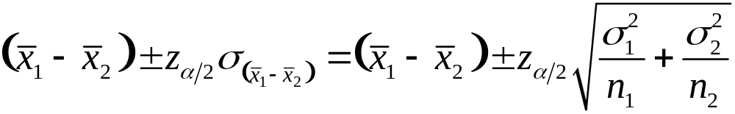
Large-Sample Confidence Interval for (μ₁ – μ₂)
© 2011 Pearson Education, Inc

Slide 12
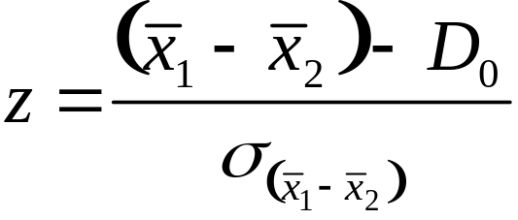
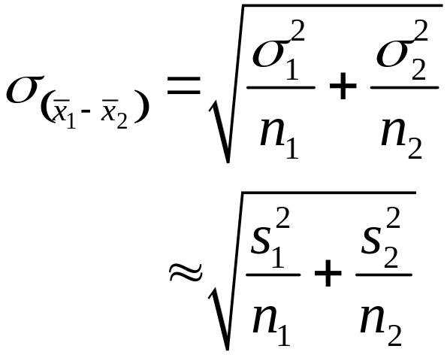
Large-Sample Test of Hypothesis for (µ₁ – µ₂)
One-Tailed Test
H₀: (µ₁ – µ₂) = D₀
H_{a}: (µ₁ – µ₂) < D₀ [or H_{a}: (µ₁ – µ₂) > D₀ ]
where D₀ = Hypothesized difference between the means (the difference is often hypothesized to be equal to 0)
Test statistic:
Rejection region: z < –z_{α}
[or z > z_{α} when H_{a}: (µ₁ – µ₂) > D₀ ]
© 2011 Pearson Education, Inc

Slide 13
Large-Sample Test of Hypothesis for (µ₁ – µ₂)
Two-Tailed Test
H₀: (µ₁ – µ₂) = D₀
H_{a}: (µ₁ – µ₂) ≠ D₀
where D₀ = Hypothesized difference between the means (the difference is often hypothesized to be equal to 0)
Test statistic:
Rejection region: |z| > z_{α/2}
© 2011 Pearson Education, Inc

Slide 14
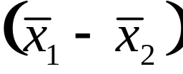




Conditions Required for Valid Large-Sample Inferences about
(μ₁ – μ₂)
1. The two samples are randomly selected in an independent manner from the two target populations.
2. The sample sizes, n₁ and n₂, are both large (i.e., n₁ ≥ 30 and n₂ ≥ 30). [Due to the Central Limit Theorem, this condition guarantees that the sampling distribution of will be approximately normal regardless of the shapes of the underlying probability distributions of the populations. Also, and will provide good approximations to and when the samples are both large.]
© 2011 Pearson Education, Inc

Slide 15
Large-Sample Confidence Interval Example
You’re a financial analyst for Charles Schwab. You want to estimate the difference in dividend yield between stocks listed on NYSE and NASDAQ. You collect the following data:
NYSE NASDAQ
Number 121 125
Mean 3.27 2.53
Std Dev 1.30 1.16
What is the 95% confidence interval
for the difference between the mean
dividend yields?
© 2011 Pearson Education, Inc
© 1984-1994 T/Maker Co.

Slide 16
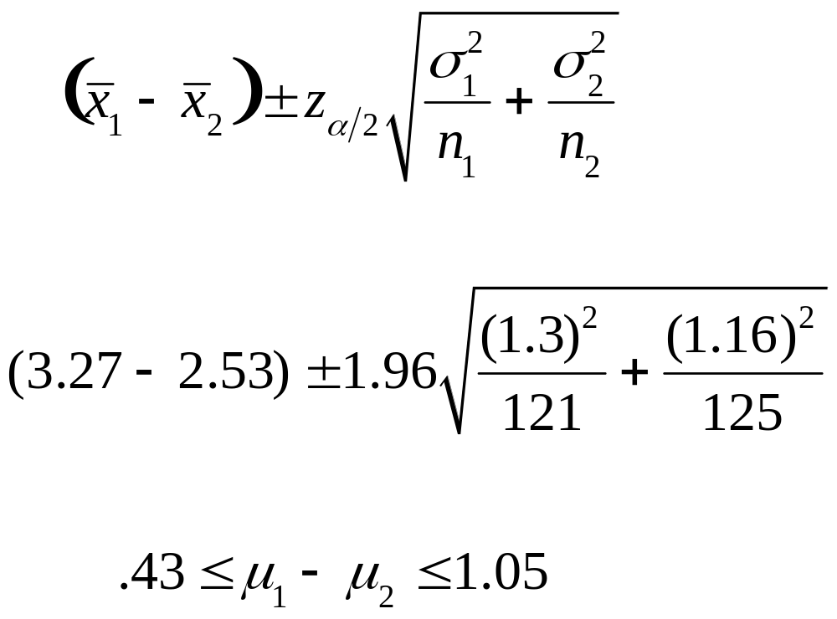
Large-Sample Confidence Interval Solution
© 2011 Pearson Education, Inc

Slide 17
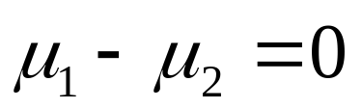
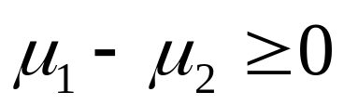
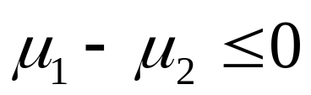
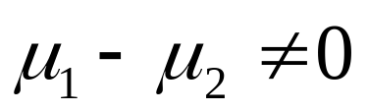
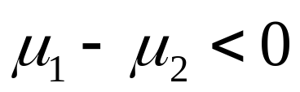
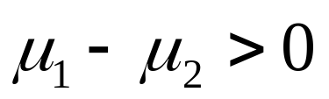
Hypotheses for Means of Two Independent Populations
Research Questions
No Difference
Pop 1
≥
Pop 2
Pop 1
≤
Pop 2
Hypothesis
Any Difference
Pop 1 < Pop 2
Pop 1 > Pop 2
H₀
H_{a}
© 2011 Pearson Education, Inc
Notes:
9

Slide 18
Large-Sample Test
Example
You’re a financial analyst for Charles Schwab. You want to find out if there is a difference in dividend yield between stocks listed on NYSE and NASDAQ. You collect the following data:
NYSE NASDAQ
Number 121 125
Mean 3.27 2.53
Std Dev 1.30 1.16
Is there a difference in average
yield (α = .05)?
© 2011 Pearson Education, Inc
© 1984-1994 T/Maker Co.

Slide 19
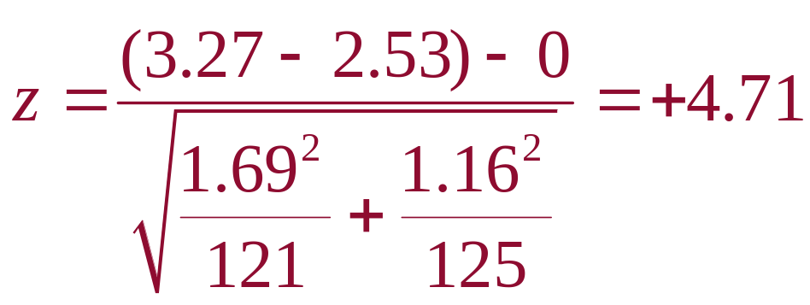
Large-Sample Test
Solution
H₀:
H_{a}:
α =
n₁= , n₂ =
Critical Value(s):
μ₁ - μ₂ = 0 (μ₁ = μ₂)
Test Statistic:
Decision:
Conclusion:
μ₁ - μ₂ ≠ 0 (μ₁ ≠ μ₂)
.05
121
125
Reject H
Reject H
Reject at α = .05
0
0
.025
.025
There is evidence of a difference in means
-1.96
0
1.96
z
© 2011 Pearson Education, Inc

Slide 20
Large-Sample Test
Thinking Challenge
You’re an economist for the Department of Education. You want to find out if there is a difference in spending per pupil between urban and rural high schools. You collect the following:
Urban Rural
Number 35 35
Mean $ 6,012 $ 5,832
Std Dev $ 602 $ 497
Is there any difference in population
means (α = .10)?
© 2011 Pearson Education, Inc
Notes:
Allow students about 15 minutes to solve.

Slide 21
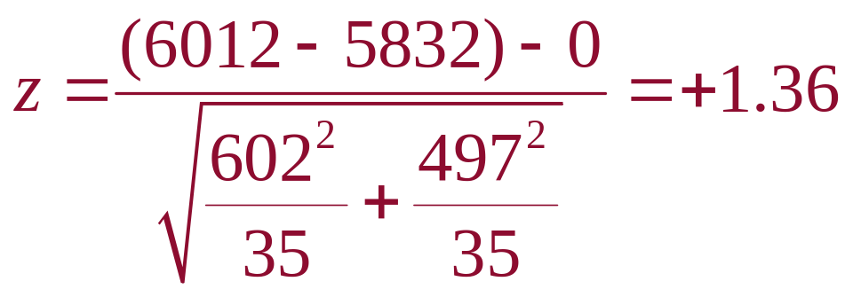
Large-Sample Test
Solution*
H₀:
H_{a}:
α =
n₁ = , n₂ =
Critical Value(s):
μ₁ - μ₂ = 0 (μ₁ = μ₂)
μ₁ - μ₂ ≠ 0 (μ₁ ≠ μ₂)
Test Statistic:
Decision:
Conclusion:
.10
35 35
Reject H
Reject H
Do not reject at α = .10
0
0
.05
.05
There is no evidence of a difference in means
-1.645
0
1.645
z
© 2011 Pearson Education, Inc

Slide 22
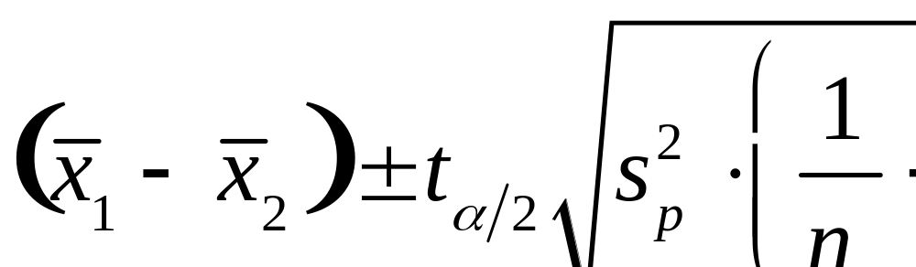
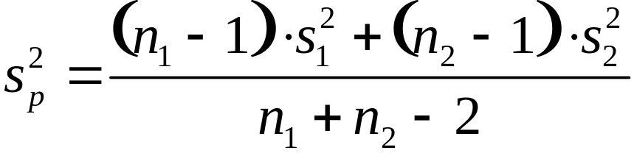
Small-Sample Confidence Interval for (μ₁ – μ₂)
(Independent Samples)
where
and t_{a/2} is based on (n₁ + n₂ – 2) degrees of freedom.
© 2011 Pearson Education, Inc

Slide 23
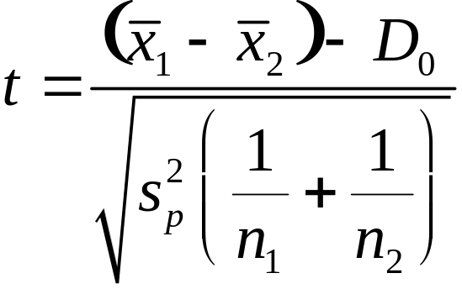
Small-Sample Test of Hypothesis for (µ₁ – µ₂)
One-Tailed Test
H₀: (µ₁ – µ₂) = D₀
H_{a}: (µ₁ – µ₂) < D₀ [or H_{a}: (µ₁ – µ₂) > D₀ ]
Test statistic:
Rejection region: t < –t_{α}
[or t > t_{α} when H_{a}: (µ₁ – µ₂) > D₀ ]
where t_{α} is based on (n₁ + n₂ – 2) degrees of freedom.
© 2011 Pearson Education, Inc

Slide 24
Small-Sample Test of Hypothesis for (µ₁ – µ₂)
Two-Tailed Test
H₀: (µ₁ – µ₂) = D₀
H_{a}: (µ₁ – µ₂) ≠ D₀
Test statistic:
Rejection region: |t| > t_{α /2}
where t_{a/2} is based on (n₁ + n₂ – 2) degrees of freedom.
© 2011 Pearson Education, Inc

Slide 25

Conditions Required for Valid Small-Sample Inferences about
(μ₁ – μ₂)
1. The two samples are randomly selected in an independent manner from the two target populations.
2. Both sampled populations have distributions that are approximately equal.
3. The populations variances are equal (i.e., ).
© 2011 Pearson Education, Inc

Slide 26
Small-Sample Confidence Interval Example
You’re a financial analyst for Charles Schwab. You want to estimate the difference in dividend yield between stocks listed on the NYSE and NASDAQ. You collect the following data:
NYSE NASDAQ
Number 11 15
Mean 3.27 2.53
Std Dev 1.30 1.16
Assuming normal populations, what
is the 95% confidence interval
for the difference between the
mean dividend yields?
© 2011 Pearson Education, Inc
© 1984-1994 T/Maker Co.

Slide 27
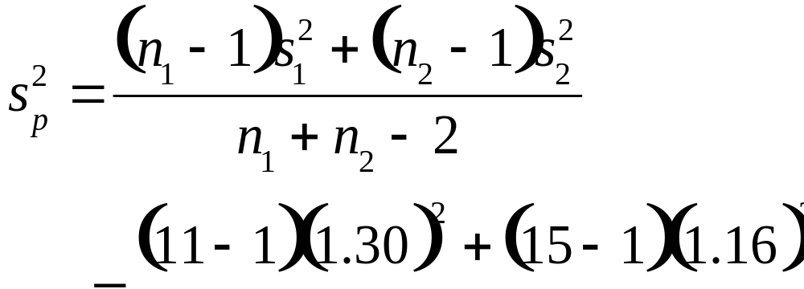
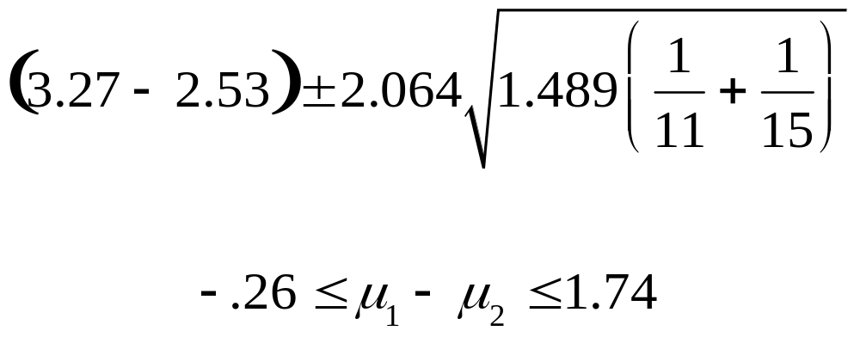
Small-Sample Confidence Interval Solution
df = n₁ + n₂ – 2 = 11 + 15 – 2 = 24 t_{.025} = 2.064
© 2011 Pearson Education, Inc
Notes:
42

Slide 28
Small-Sample Test
Example
You’re a financial analyst for Charles Schwab. Is there a difference in dividend yield between stocks listed on the NYSE and NASDAQ? You collect the following data:
NYSE NASDAQ
Number 11 15
Mean 3.27 2.53
Std Dev 1.30 1.16
Assuming normal populations,
And population variances are equal
is there a difference in average
yield (α = .05)?
© 2011 Pearson Education, Inc
© 1984-1994 T/Maker Co.

Slide 29
Small-Sample Test
Solution
μ₁ – μ₂ = 0 (μ₁ = μ₂)
H₀:
H_{a}:
α =
df =
Critical Value(s):
μ₁ – μ₂ ≠ 0 (μ₁ ≠ μ₂)
.05
11 + 15 – 2 = 24
Reject H
Reject H
0
0
.025
.025
-2.064
0
2.064
t
© 2011 Pearson Education, Inc
Notes:
41

Slide 30
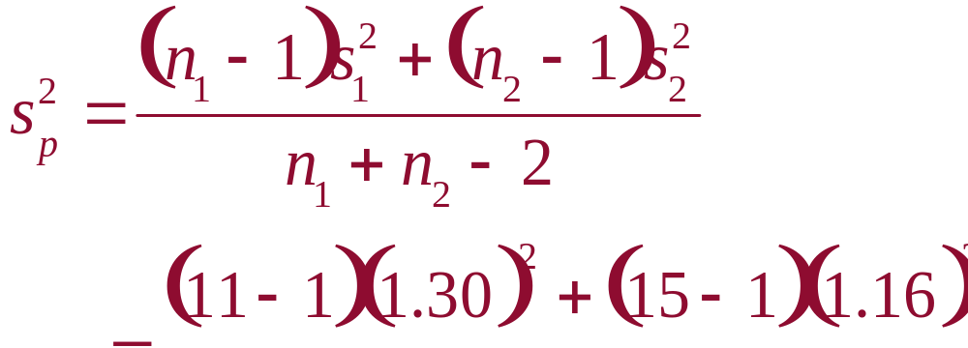
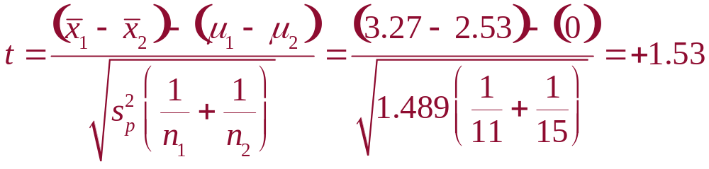
Small-Sample Test
Solution
© 2011 Pearson Education, Inc
Notes:
42

Slide 31

Small-Sample Test
Solution
μ₁ – μ₂ = 0 (μ₁ = μ₂)
H₀:
H_{a}:
α =
df =
Critical Value(s):
Test Statistic:
Decision:
Conclusion:
μ₁ – μ₂ ≠ 0 (μ₁ ≠ μ₂)
.05
11 + 15 – 2 = 24
Reject H
Reject H
Do not reject at α = .05
0
0
.025
.025
There is no evidence of a difference in means
-2.064
0
2.064
t
© 2011 Pearson Education, Inc
Notes:
41

Slide 32
Small-Sample Test
Thinking Challenge
You’re a research analyst for General Motors. Assuming equal variances, is there a difference in the average miles per gallon (mpg) of two car models (α = .05)?
You collect the following:
Sedan Van
Number 15 11
Mean 22.00 20.27
Std Dev 4.77 3.64
© 2011 Pearson Education, Inc
Notes:
43
Allow students about 15 minutes to solve.

Slide 33
Small-Sample Test
Solution*
μ₁ – μ₂ = 0 (μ₁ = μ₂)
H₀:
H_{a}:
α =
df =
Critical Value(s):
μ₁ – μ₂ ≠ 0 (μ₁ ≠ μ₂)
.05
15 + 11 – 2 = 24
Reject H
Reject H
0
0
.025
.025
-2.064
0
2.064
t
© 2011 Pearson Education, Inc
Notes:
45

Slide 34
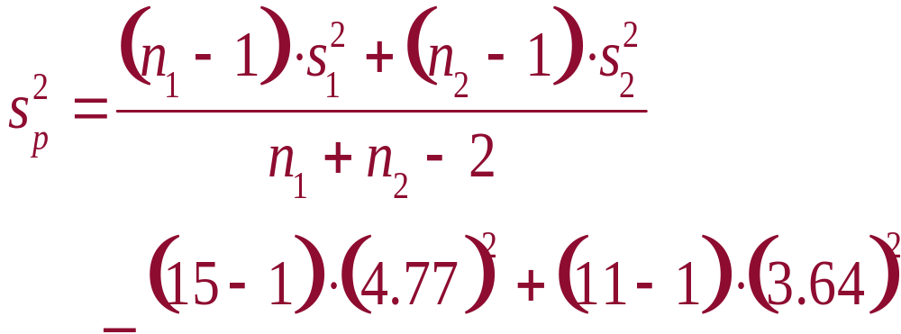
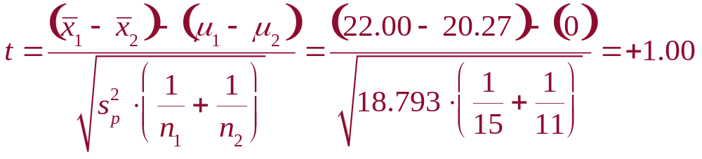
Small-Sample Test
Solution*
© 2011 Pearson Education, Inc
Notes:
46

Slide 35

Small-Sample Test
Solution*
μ₁ – μ₂ = 0 (μ₁ = μ₂)
H₀:
H_{a}:
α =
df =
Critical Value(s):
Test Statistic:
Decision:
Conclusion:
μ₁ – μ₂ ≠ 0 (μ₁ ≠ μ₂)
.05
15 + 11 – 2 = 24
Reject H
Reject H
Do not reject at α = .05
0
0
.025
.025
There is no evidence of a difference in means
-2.064
0
2.064
t
© 2011 Pearson Education, Inc
Notes:
45

Slide 36
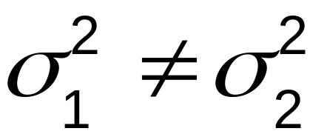
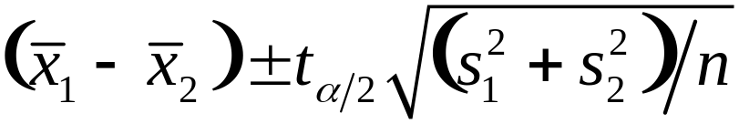
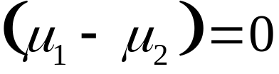
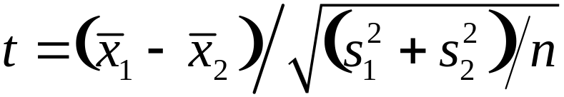
Approximate Small-Sample Procedures when
1. Equal sample sizes (n₁ = n₂ = n)
Confidence interval:
Test statistic H₀:
where t is based on v = n₁ + n₂ – 2 = 2(n – 1) degrees of freedom.
© 2011 Pearson Education, Inc

Slide 37
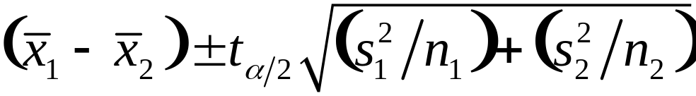
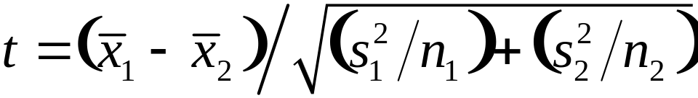
Approximate Small-Sample Procedures when
2. Unequal sample sizes (n₁ ≠ n₂)
Confidence interval:
Test statistic H₀:
where t is based on degrees of freedom equal to . . .
© 2011 Pearson Education, Inc

Slide 38
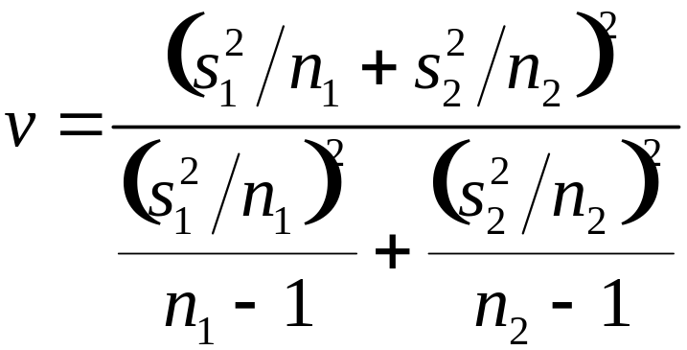
Approximate Small-Sample Procedures when
Note: The value of v will generally not be an integer. Round v down to the nearest integer to use the t-table.
© 2011 Pearson Education, Inc

Slide 39
What Should You Do if the Assumptions Are Not Satisfied?
If you are concerned that the assumptions are not satisfied, use the Wilcoxon rank sum test for independent samples to test for a shift in population distributions. See Chapter 14.
© 2011 Pearson Education, Inc

